Slide 1
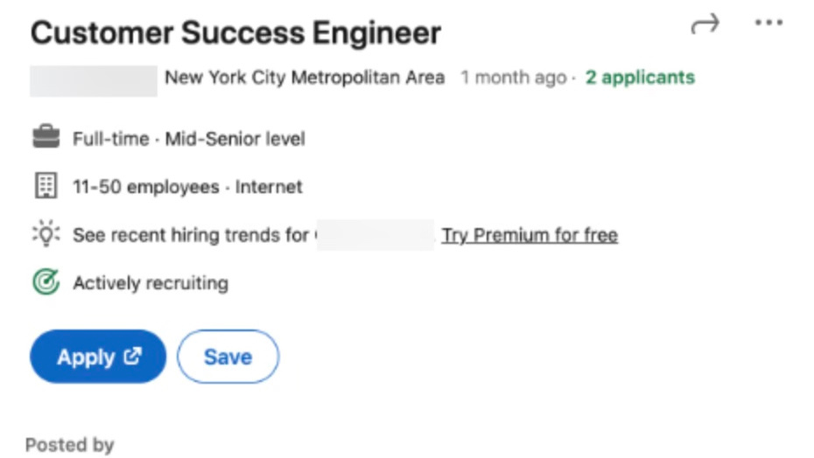

Job Listing “Integrity“ Investigation
By: Dian Jin, Mingze Wu, Tanvi Sheth, Sneha Ekka, Jenil Shah

Slide 2
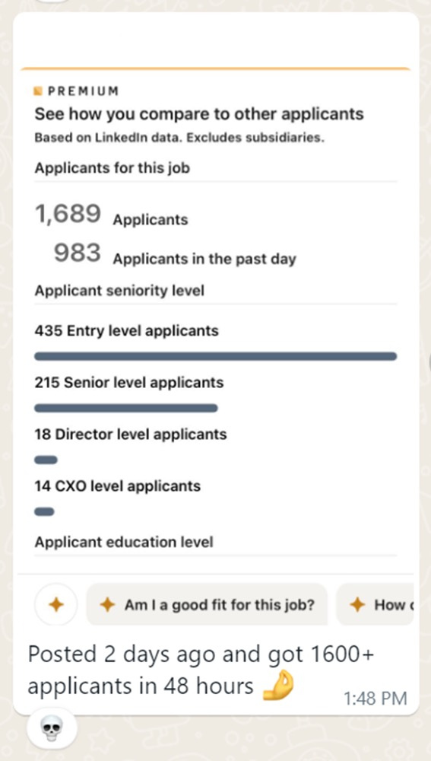
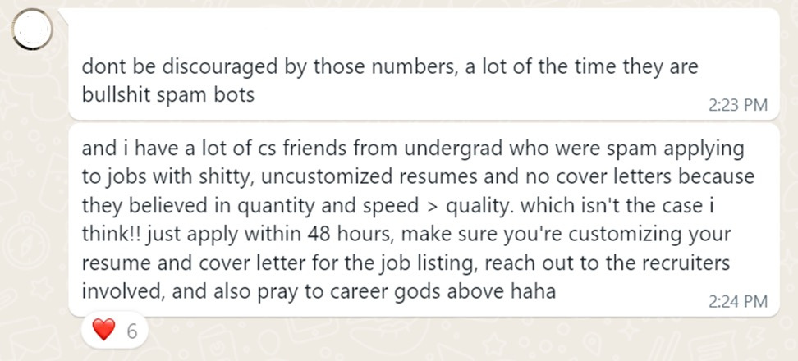

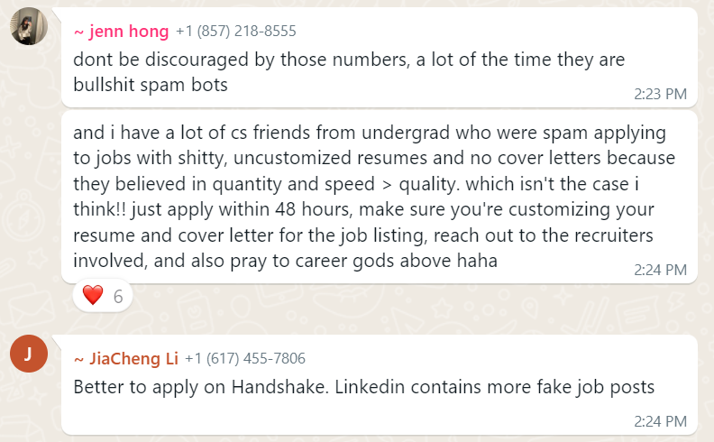
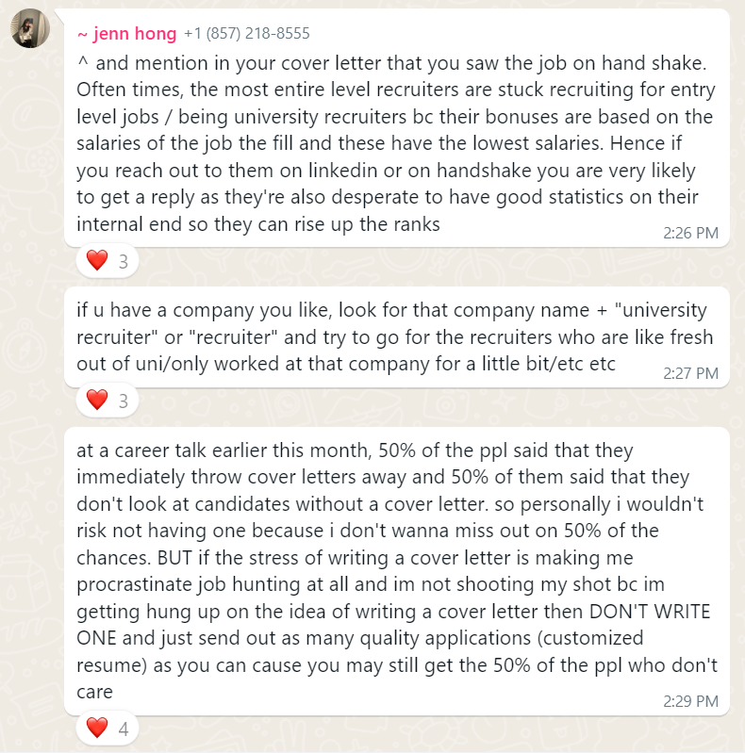
Motivation

Slide 3

INTRODUCTION
Motivation
01
02
03
Authenticity of job postings MATTERS
Spam/fake posts everywhere
Important to build a trustworthy environment for recruiters and candidates

Slide 4
INTRODUCTION
Problem Statement
01
02
Process textual job posting information and draw out patterns that distinguish fraudulent jobs from real ones
Offer an automated and reliable solution that can enhance the detection of fraudulent postings

Slide 5
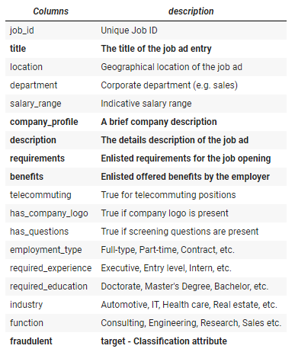
INTRODUCTION
Data Overview
KEY FEATURES
01
Real / Fake Job Posting Prediction Dataset from Kaggle
TEXTUAL
INFORMATION
02
Collected by The University of the Aegean | Laboratory of Information & Communication Systems Security
03
17880 job postings
04
18 features
TARGET

Slide 6
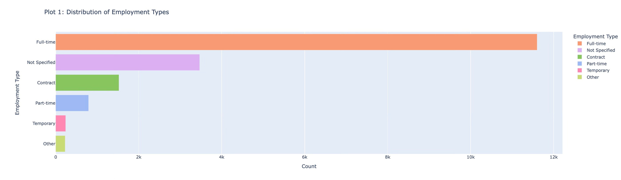
GRAPHS
Data Insights
Majority Full-time employees
Unspecified employment types
16.8% of positions are non-full time roles
Over 11,000 postings offer full-time positions
Significant portion of the workforce
Contract, part-time, temporary, and other roles constitute about 3,000 positions

Slide 7
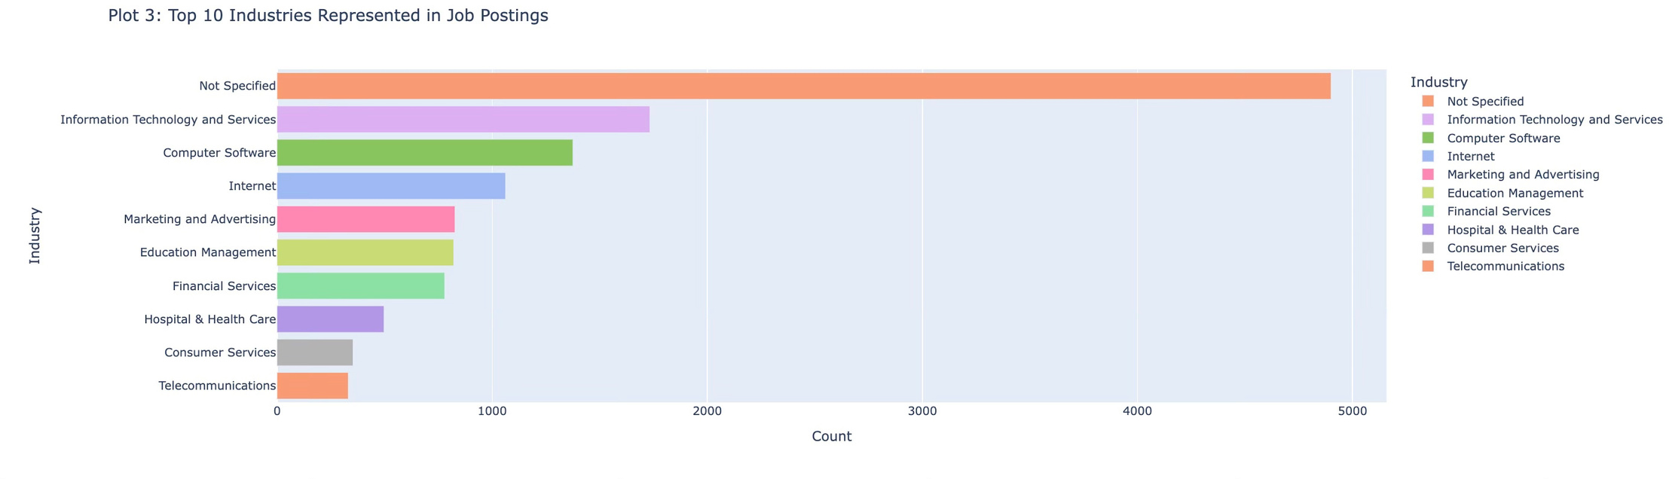
GRAPHS
Data Insights
Majority of ‘Not Specified’ job postings
Technology represents about 23.35% jobs
Wide ranges of industries hiring!
About 9 industries are actively hiring.
Close to 5000 postings show ‘Not Specified’ job positions
Infomation Technology and Services, Computer Software and Internet represents top 3 industries

Slide 8
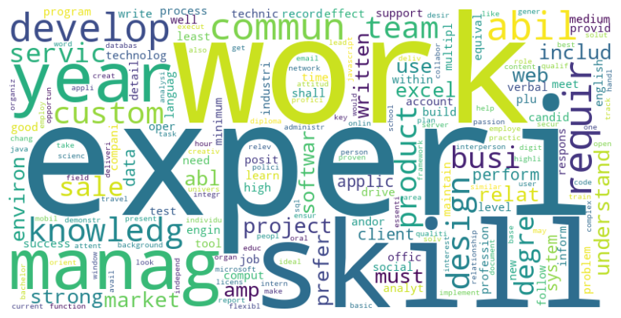
WORD CLOUD
Requirements

Slide 9
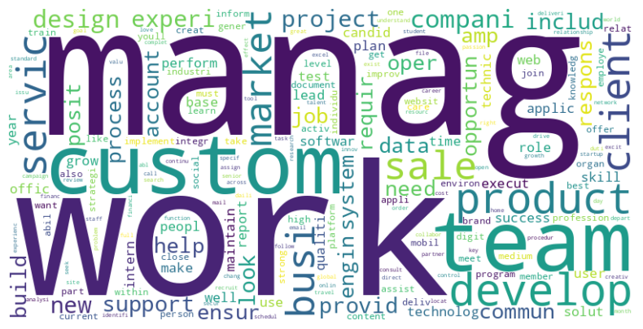
WORD CLOUD
Job descriptions

Slide 10
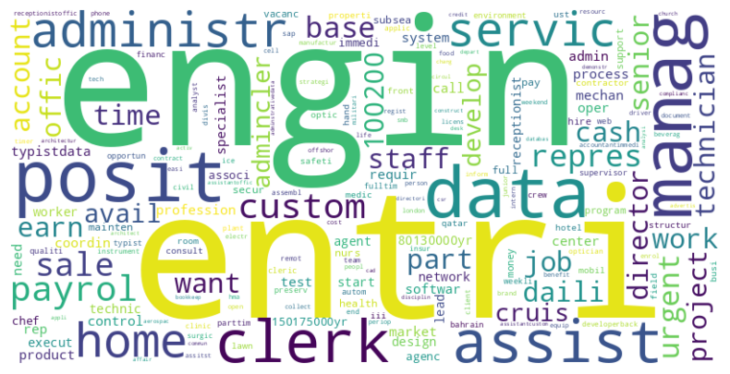
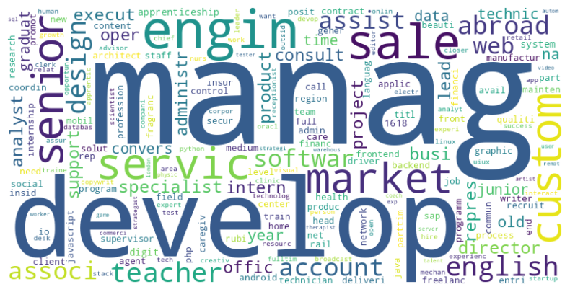
WORD CLOUD
Fake vs Real Jobs
“Fake” Titles
“Real” Titles

Slide 11
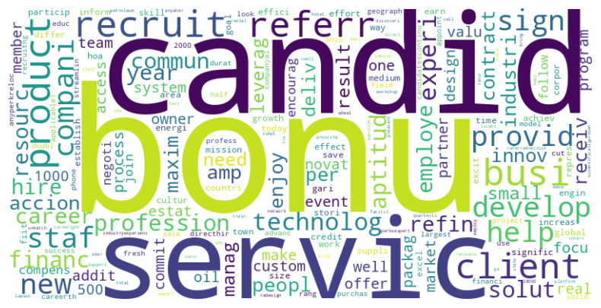
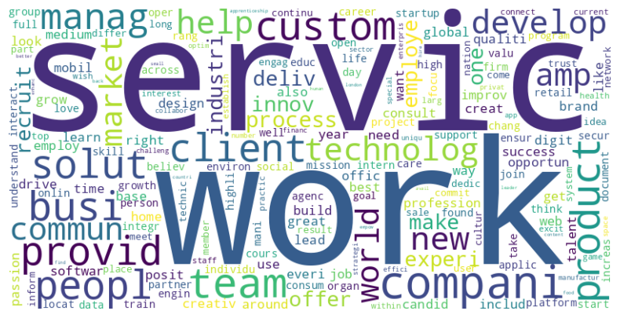
WORD CLOUD
Fake vs Real Jobs
“Fake” Company Profiles
“Real” Company Profiles

Slide 12
ANALYSIS & MODELING
Project Plan
01.
03.
05.
Tokenization
Dimensionality Reduction
Hyper-Parameter Tuning
Reducing job listings to a compressed list of words to work with.
Reducing the enormous “text representation” down to a reasonable no. of features.
Experimenting with multiple classification algorithms & tuning them to build accurate models.
02.
04.
06.
Vectorization
SMOTE
Model Selection
Using Tfidf to generate WordCloud and using
Word2Vec for downstream classification.
Dealing with the huge class imbalance to perform ML algorithms appropriately.
Comparing the results of different classification models.

Slide 13
ANALYSIS & MODELING
Comparing Results
Logistic Regression
Random Forest
SVC
XGBoost
Stacking
F1 Score
0.468
0.764
0.816
0.803
0.762
Balanced Accuracy
0.884
0.860
0.864
0.874
0.809

Slide 14
“salary_range”
Clustering
CONCLUSION
Challenges
Missing and invalid values
Multiple currencies
Varying country standards
Assumed clustering would help identify fraudulent job listings

Slide 15
CONCLUSION
Limitations
‘word2vec’
Model
Class
Imbalance
Vectorizer Comparisons
Hyper-parameter selection
4.8% of data is fraudulent
word2vec VS GloVe
Limited time and resources
Used pre-defined combinations for arguments
Implemented SMOTE
Unable to verify effectiveness
Possibility of Overfitting
Inability to find pre-trained models on job listings

Slide 16
Verifying Legitimacy of Job postings
Starting point for a more complex model
CONCLUSION
Implications
Using this model, platforms can verify the legitimacy of job postings to maintain the trust of users
Can build on this to create a more intricate model with hyper-parameters and train it on data from all different job posting platforms

Slide 17
Thank You!
Questions?

